Slide 1
AIRCRAFT CHARTER SERVICE
JOYS JOHNEY
DD15

Slide 2
INTRODUCTION
The Aircraft charter service is an integrated software application developed for the purpose of charting aircraft . The website automates the process of viewing, booking, cancelling aircraft charters online.

Slide 3
Project Description
The main objective of the application is to automate the existing system of reservation of aircraft charter. This application developed allows customers to book & chart their aircraft according to their needs online with selection of destinations.

Slide 4
Software requirements
Front end : Microsoft ASP.NET 2013 with Visual C#
Back end : Microsoft SQL server management 2012
Developmental tool : Adobe Photoshop, MS Office

Slide 5
Hardware requirements
Operating system : Microsoft Window 7 or higher
Processor : Intel Core i3 or higher
RAM : 2GB minimum
Hard disk : 4GB minimum

Slide 6
Existing system
In the present system a customer has to approach several admin offices of various travel agents and airports for getting information & reservation. This often requires a lot of time and effort. A customer may not get the desired information from these offices and often the customer may be misguided. It is tedious for a customer to get information about the aircraft of his/her needs and get the bookings done.

Slide 7
Proposed system
To Create Web Based Application For our Organization.
To Provide Search Facility For Customer.
To Generate Different Types of Reports.
To provide online aircraft charter and payment facility to the customer.
To provide reservation informations.
To provide customer with a wide range of travel destinations to choose from.
Customer Can Cancel the Booking then Return 15% Less Deduct From the Amount.

Slide 8
Admin module description
Registration
The registration here gives admin to open a account in the the software .
Login
Login module helps the check the genunity of the admin.
Manage aircraft info
Manage aircraft info module helps in adding, deleting and updating various info related to aircraft.
Reports
Reports helps admin in understanding the overall performance of the software in an economic perspective.

Slide 9
Passenger module description
Registration
The registration here gives user to open account in the the software .
Login
Login module helps in checking the genunity of the user.
Bookings
Helps the user in making bookings according to their requirements.
Payment
Paying for the bookings made is done through this module

Slide 10
Cancellation
Helps in cancelling the bookings made
Ticket
Helps with the viewing & confirmation of the booking the passenger has made. And this is the only report that the user gets.

Slide 11
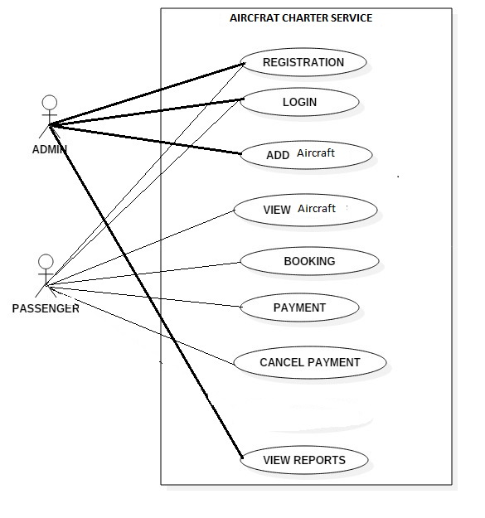
Use case diagram

Slide 12
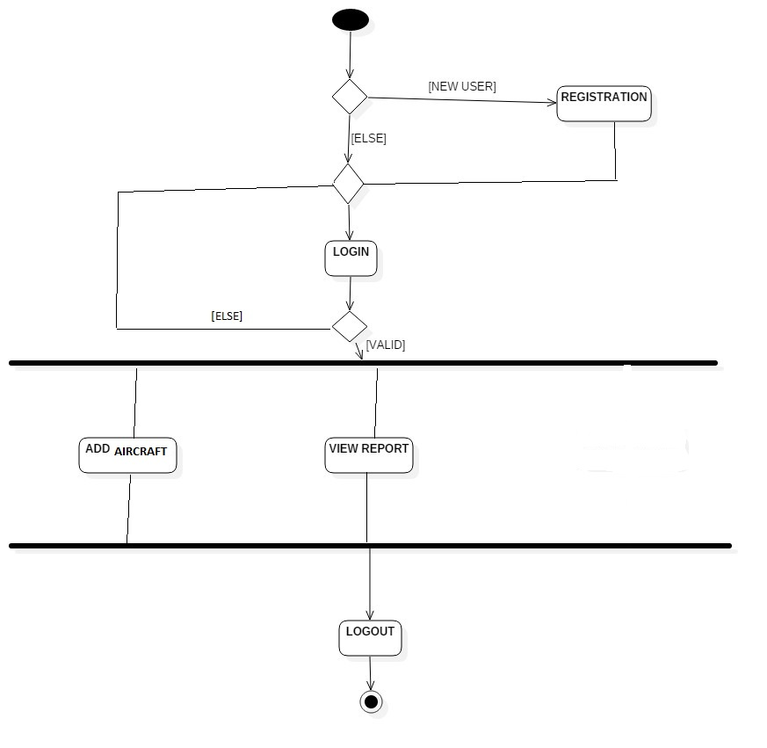
ACTIVITY DIAGRAM ADMIN

Slide 13
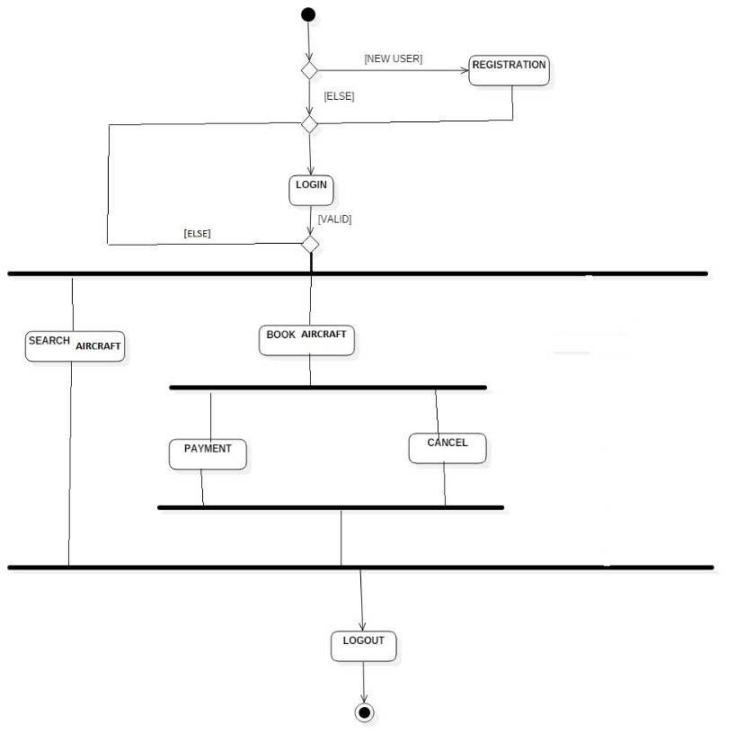
ACTIVITY DIAGRAM PASSENGER

Slide 14
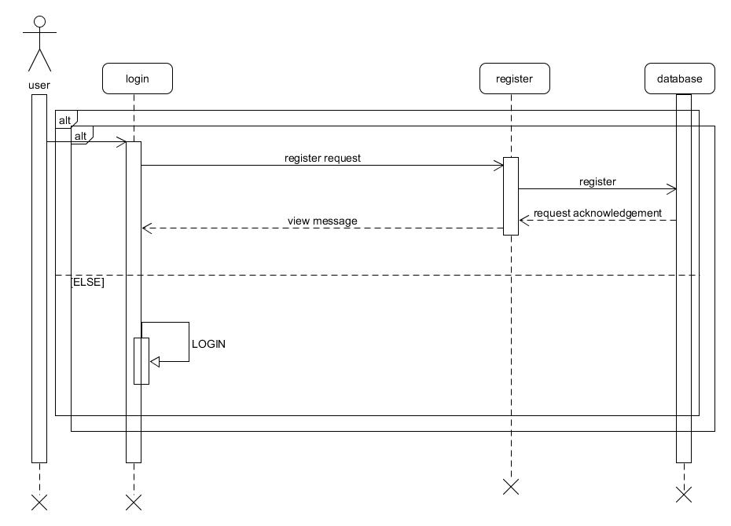
System sequence diagram login

Slide 15
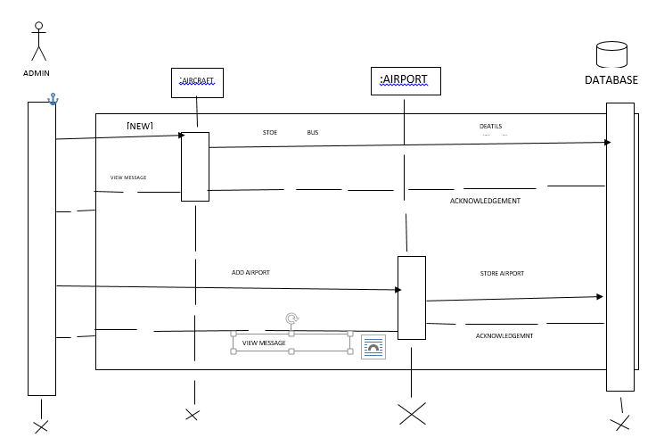
System Sequence Diagram Admin

Slide 16
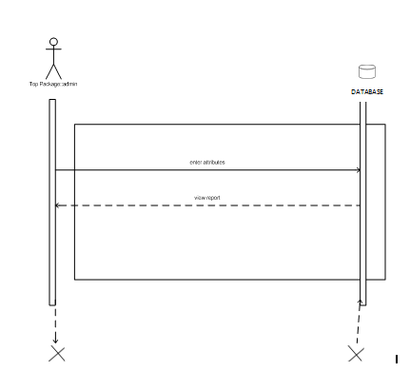
System sequence diagram Admin report

Slide 17
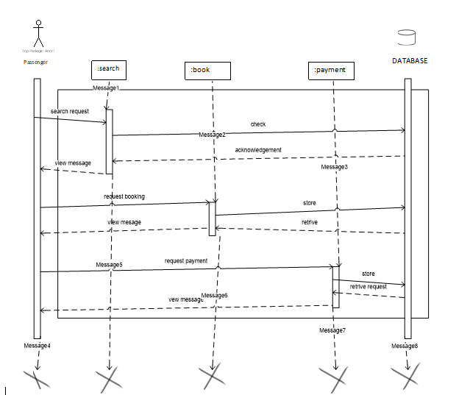
System sequence diagram Process User

Slide 18
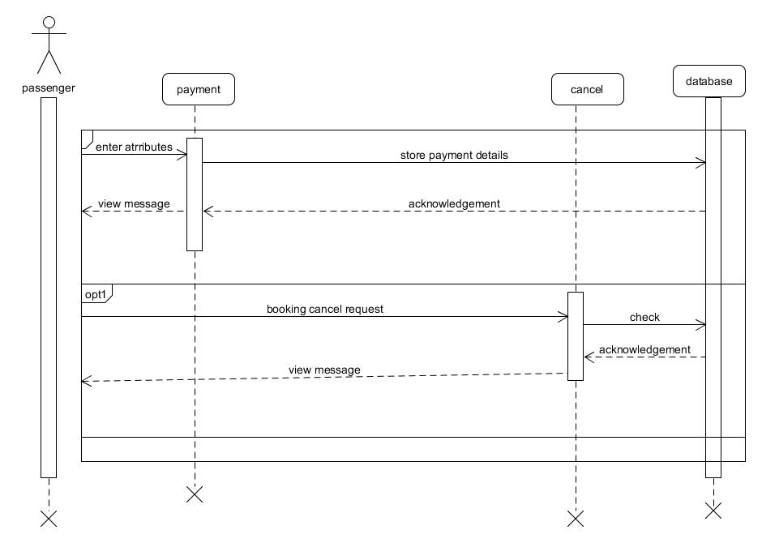
System sequence diagram Process USER

Slide 19
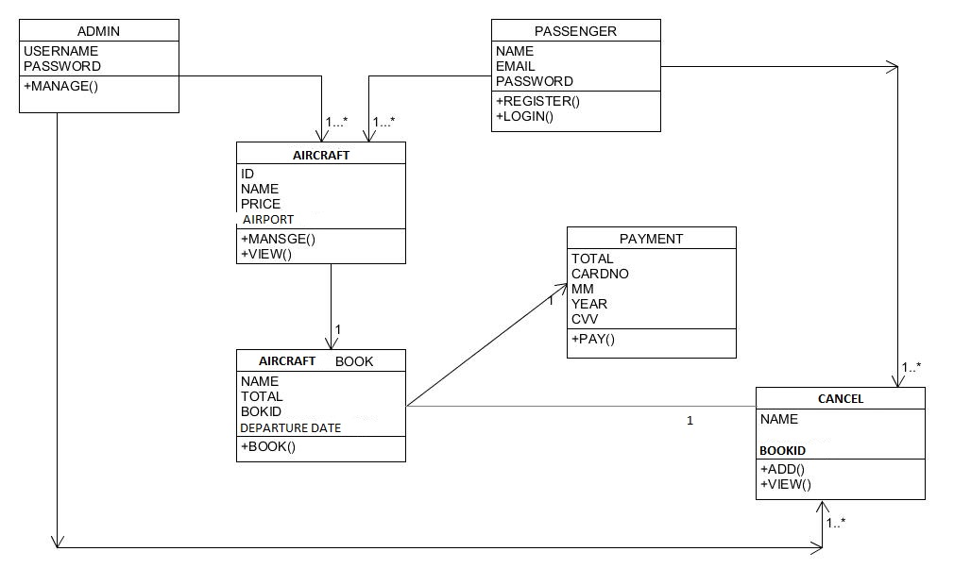
Class diagram

Slide 20
Table design

Slide 21
Registration table
field | Datatype & size | description | constraints
email id | Varchar(10) | Email id of users | Not null
password | Varchar(10) | Password of the user. | Not null

Slide 22
AIRPORT table
field | Datatype & size | description | constraints
id | Varchar(10) | ID for each airport | Not null, PK
Name | Varchar(10) | For storing airport name. | Not null

Slide 23
Aircraft table
field | Datatype & size | description | constraints
Id | Varchar(10) | For aircraft id | Pk, not null
Aircraft name | Varchar(20) | Name of the aircraft | Not null
Seats | Int | No. of seats in aircraft | Not null
Price | Varchar(10) | Price per plane | Not null
Image | Image | Images of aircraft | Not null

Slide 24
Booking table
field | Datatype & size | description | constraints
Book id | Varchar(20) | Booking id | PK
Full name | Varchar(10) | Name of the passenger | Not null
Email id | Varchar(10) | Email id of various . | Not null
Flight Name | Varchar(10) | Flight identification | Not null
Departure airport | Varchar(10) | For departure airport | Not null
Arrival airport | Varchar(10) | For arrival airport | Not null
Date | Date | For travel date | Not null
Time | Varchar(10) | For travel time | Not null

Slide 25
Payment table
field | Datatype & size | description | constraints
Name | Varchar(10) | For storing name | Not null
Card no | int | Card no | Not null
Month | Varchar(10) | For expiry month | Not null
Year | Int | For expiry year | Not null
Total | Varchar(10) | For storing total amount | Not null

Slide 26
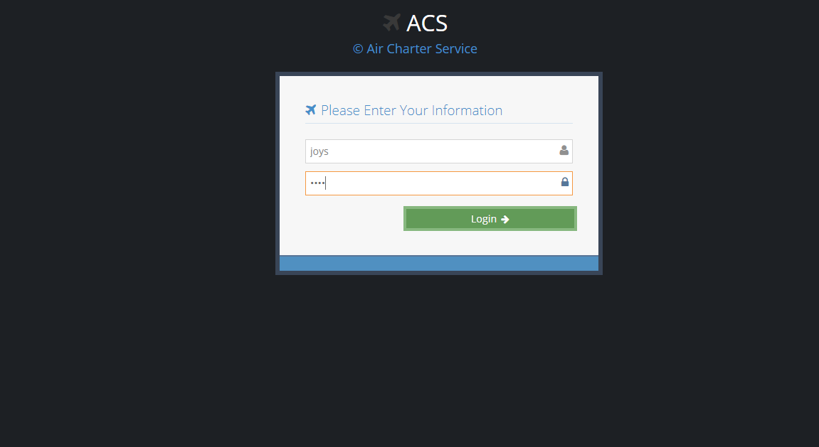

Slide 27
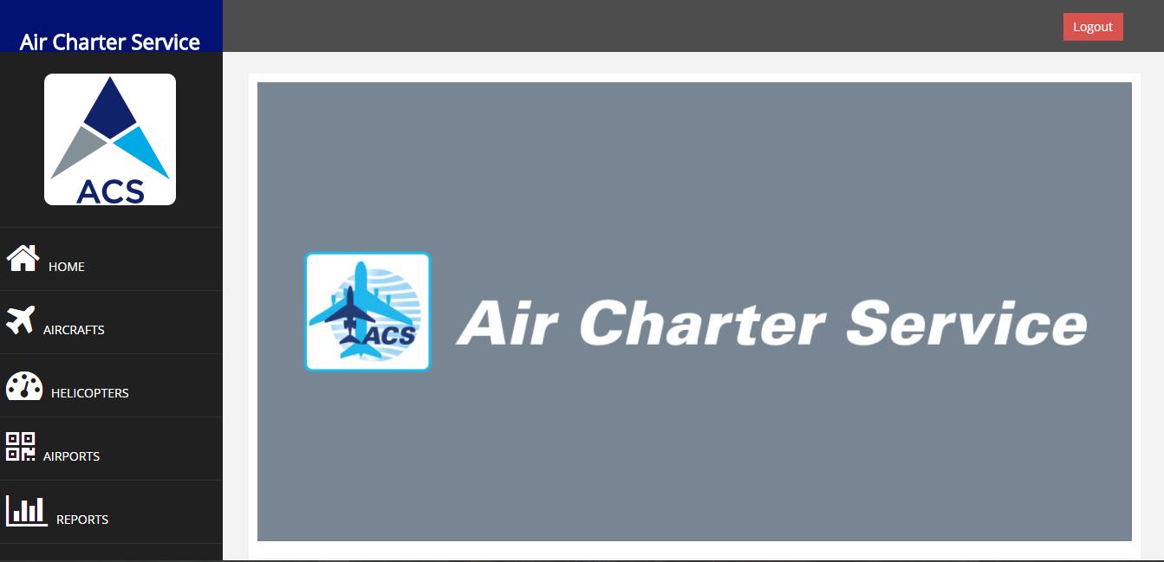

Slide 28
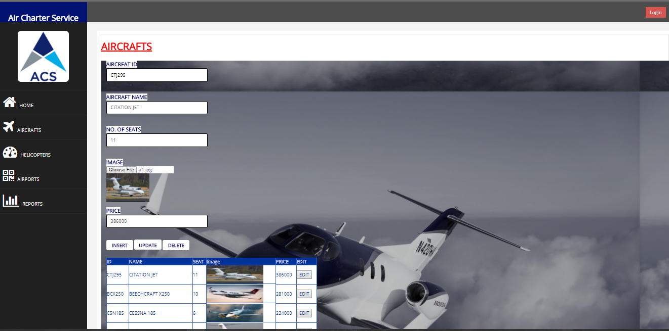

Slide 29
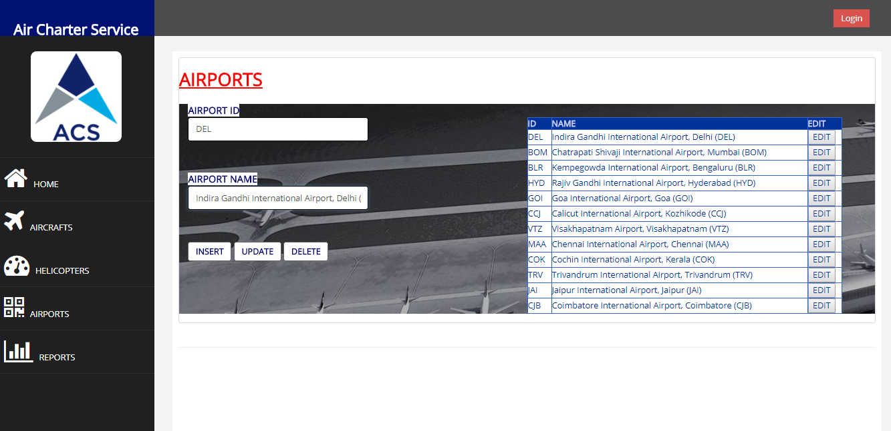

Slide 30
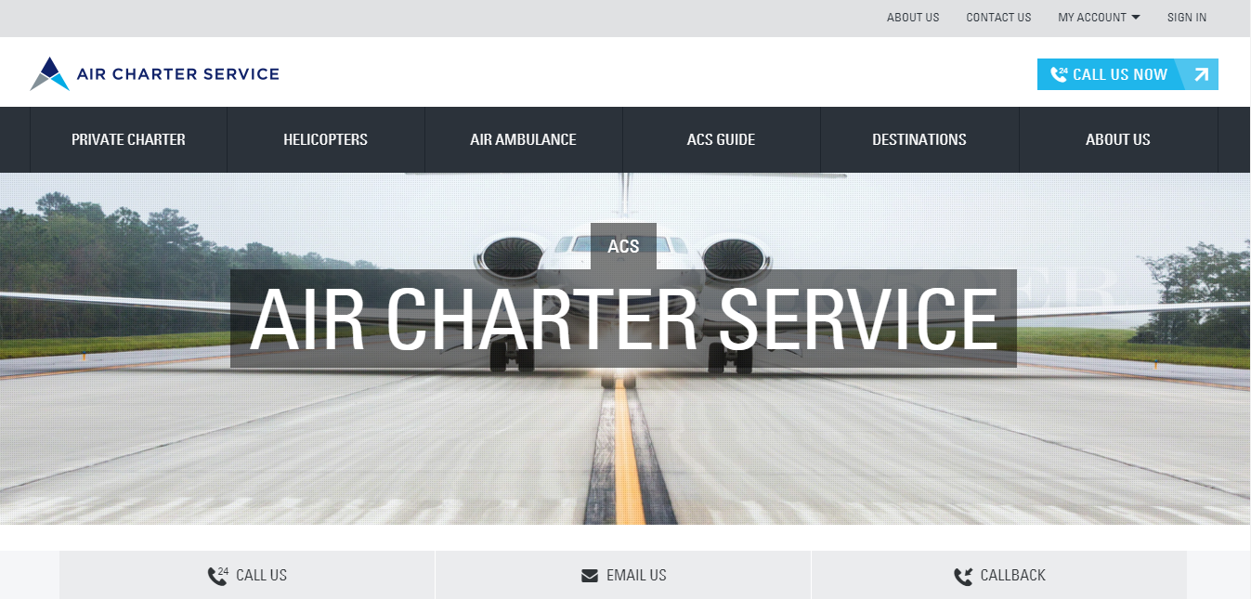

Slide 31
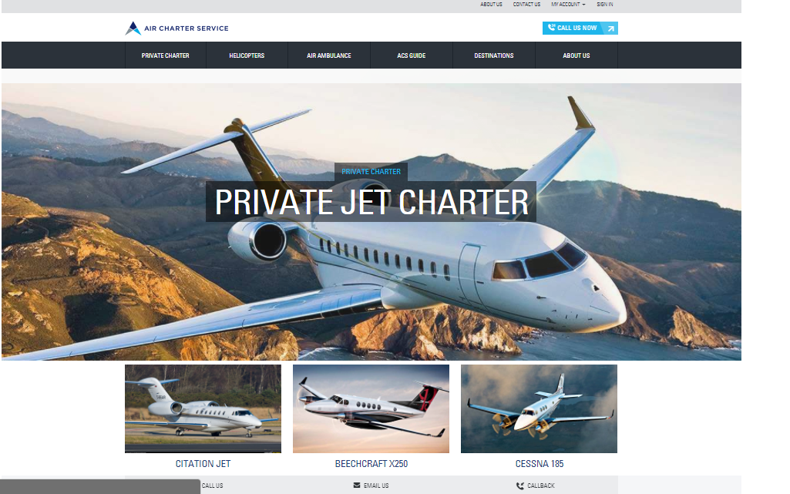

Slide 32
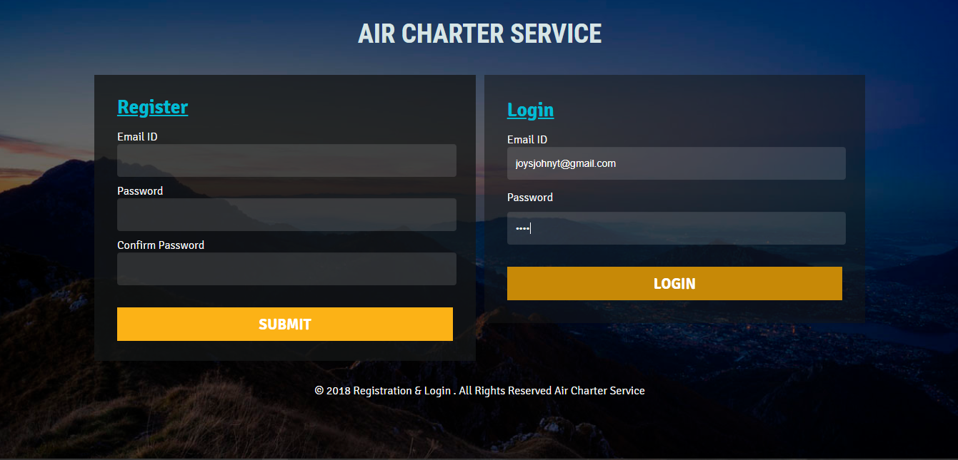

Slide 33
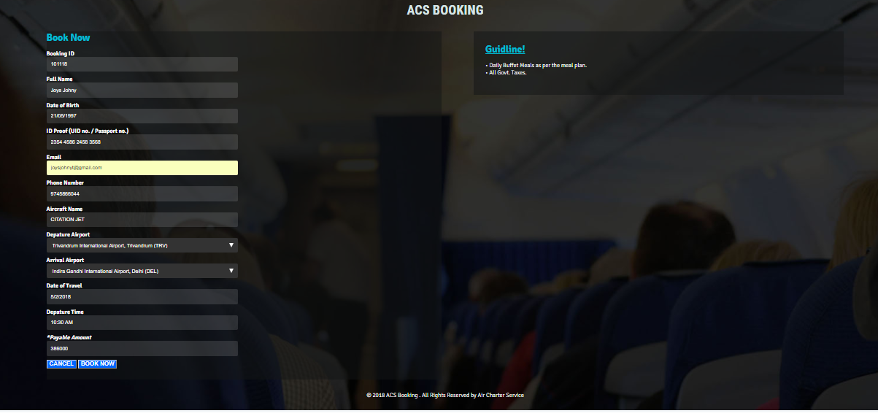

Slide 34
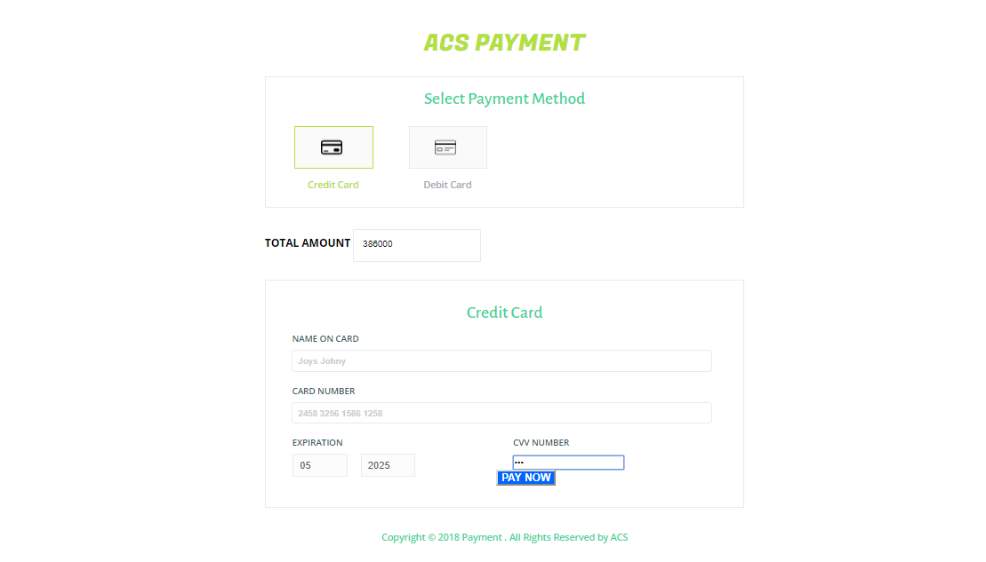

Slide 35
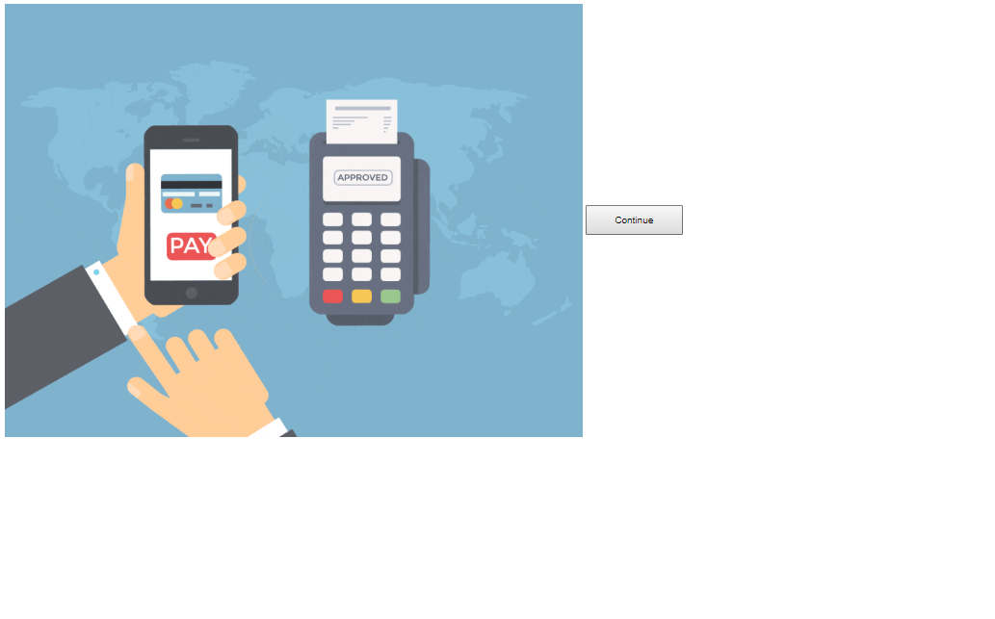

Slide 36
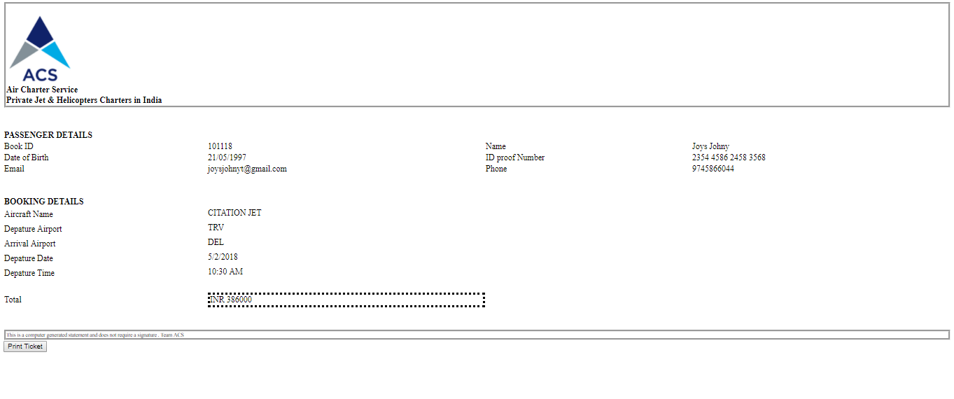

Slide 37
Future enhancements
The software will be updated to accommodate various seasonal needs for making it maximum user friendly.
Frequent users will be awarded with allowances as apart of better customer support.
More number of aircraft will be added to the system, giving the user with more choices.

Slide 38
conclusion
The aircraft charter system helps in automation of traditional aircraft charter booking using this system customers can avoid hectic booking procedures and book their ticket as is possible.
This also allows for better customer service as this system deals only with aircraft charter.

Slide 39
THANK YOU

